Slide 1
Lecture 11b
DHCP; Domain Name System; ICMP

Slide 2
IP addresses: How does a device get one?
Network administrators can organize a block of IP address according to their preference
Allocation to devices: static vs. dynamic
Static
Assigned and configured at startup
Permanently dedicated to a device
Typically hard-coded by system admin in a file
Difficult to scale and manual assignment is very prone to errors
Difficult to manage
people leave the organization and “forget” to return addresses
Duplicate addresses may get assigned
Typically used for 24x7 devices - servers

Slide 3

IP addresses: How does a Host get one?
Why Dynamic IP addresses?
At any given time, only a small fraction of the computers are actually communicating with other computers outside the organization
Dynamic IP address assignment is attractive
Techniques for Dynamic assignment
IP Addresses are “leased” from a pool
Especially behind a LAN or ISP
“Real” (globally unique)
Use Dynamic Host Configuration Protocol (DHCP)
Locally unique – behind the gateway/router
Use a Network Address Translator (NAT)

Slide 4
Dynamic Host Configuration Protocol
DHCP enables programmatic assignment and collection of IP addresses
Client configuration is hands-free
DHCP server manages the pool of available IP addresses
Defined in IETF RFC 2131 (March 1997)

Slide 5
3 Ways to Allocate IP addresses with DHCP
Automatic: permanent assignment
Popular for servers, wireless APs, etc.
Manual: fixed but refreshed periodically
Popular for support devices such as printers
Dynamic: leased for short time from address pool
Allows address reuse
Popular in ISPs and enterprise clients
Provides support for mobile users

Slide 6
DHCP dynamic allocation
Allows automatic reuse of an address when it is no longer needed by the computer to which it was assigned
Useful when computers will only be connected intermittently to the network
Or when computers are not servers
Each subnet has access to at least one DHCP server
All DHCP clients look for a DHCP server upon startup to get network parameters
DHCP server provides an IP address for a fixed duration in response to a client’s DHCP request
Attempts to provide same address as before if possible

Slide 7
DHCP – address leasing
DHCP server also provides all network configuration information client needs to operate
This includes subnet mask, network domain, default gateway etc.
Duration of address assignment is called lease-time
The client can request the DHCP server for an extension of the lease before the lease expires
In a typical DHCP client-server interaction
Client sends a DHCP DISCOVER
Server responds with DHCP OFFER
DHCP REQUEST broadcasts client selection
Selected server sends DHCP ACK
If graceful shutdown client sends DHCP Release when done

Slide 8
DHCP client-server example
A
223.1.1.1
DHCP
223.1.2.1
server
223.1.1.2
223.1.1.4
223.1.2.9
B
223.1.2.2
E
arriving DHCP
client needs
address in this
network
223.1.1.3
223.1.3.27
223.1.3.1
223.1.3.2

Slide 9
DHCP Operations – I
New Host broadcasts a Discover message via UDP to Port 67
Destination address: 255.255.255.255
Source address: 0.0.0.0
DHCP server responds with an Offer message
Transaction ID of Discover
Proposed IP address
Network mask
IP address lease time

Slide 10
DHCP Operations – II
New Host responds with a DHCP Request
Mirrors information in Offer – may select configuration options
Goes to selected DHCP server in the case of multiple servers
Server responds with a DHCP ACK
Confirms parameters
Initiates lease
Leases can be renewed upon expiration

Slide 11
Example
DHCP server: 223.1.2.5
arriving
client
DHCP discover
src : 0.0.0.0, 68
dest.: 255.255.255.255,67
yiaddr: 0.0.0.0
transaction ID: 654
Client-server example
DHCP offer
src: 223.1.2.5, 67
dest: 255.255.255.255, 68
yiaddrr: 223.1.2.4
transaction ID: 654
Lifetime: 3600 secs
DHCP request
src: 0.0.0.0, 68
dest:: 255.255.255.255, 67
yiaddrr: 223.1.2.4
transaction ID: 655
Lifetime: 3600 secs
time
DHCP ACK
src: 223.1.2.5, 67
dest: 255.255.255.255, 68
yiaddrr: 223.1.2.4
transaction ID: 655
Lifetime: 3600 secs

Slide 12
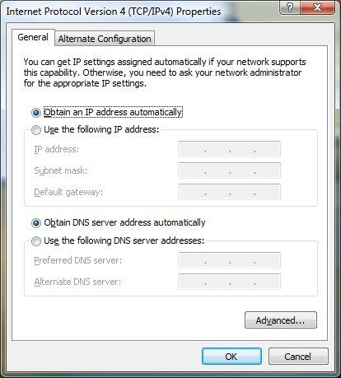
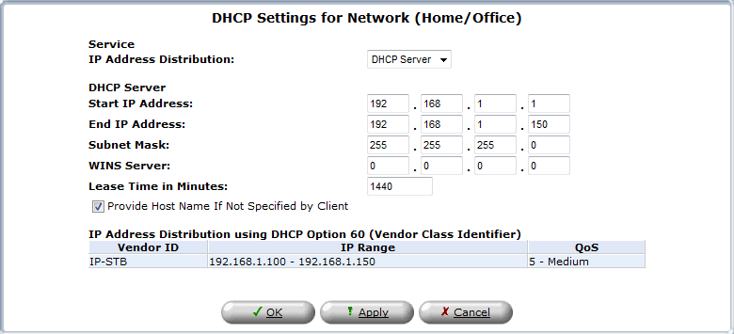
DHCP server and client settings

Slide 13
Sample dhcpd.conf
Network options
option domain-name “datacomm.example.com";
option domain-name-servers 10.1.1.1, 10.2.1.1, 10.3.1.1;
option routers 10.1.1.254;
option subnet-mask 255.255.255.128;
default-lease-time 21600;
subnet 10.1.1.128 netmask 255.255.255.128 {
range 10.1.1.236 10.1.1.253;
}
host www {
hardware ethernet 00:06:5B:CE:39:05;
fixed-address 10.1.1.2;
host-name “www.datacomm.example.com";
}
Dynamic allocation range
Manual allocation

Slide 14
IP Addressing
Q: How does an ISP get block of addresses?
A: ICANN: Internet Corporation for Assigned
Names and Numbers
allocates addresses
manages DNS
assigns domain names, resolves disputes

Slide 15
Problem with IP addresses in number form
32-bit IP addresses have two drawbacks
Routers can’t keep track of every network path
Users can’t remember dotted decimals easily
Domain names (e.g., www.pitt.edu) handle the second problem by providing a name for each network domain (hosts under the control of a given entity)

Slide 16
The need for a “Name Service”
Initially, the Internet was small, and all users maintained a hosts file to translate names to IP addresses
Entries appeared as follows:
131.247.222.249 www.usf.edu
But, as more users came online, it became difficult for end-users to maintain hosts
The need was recognized for a system
that maintained accurate name-IP address mappings
was easy to maintain
and easy to use

Slide 17
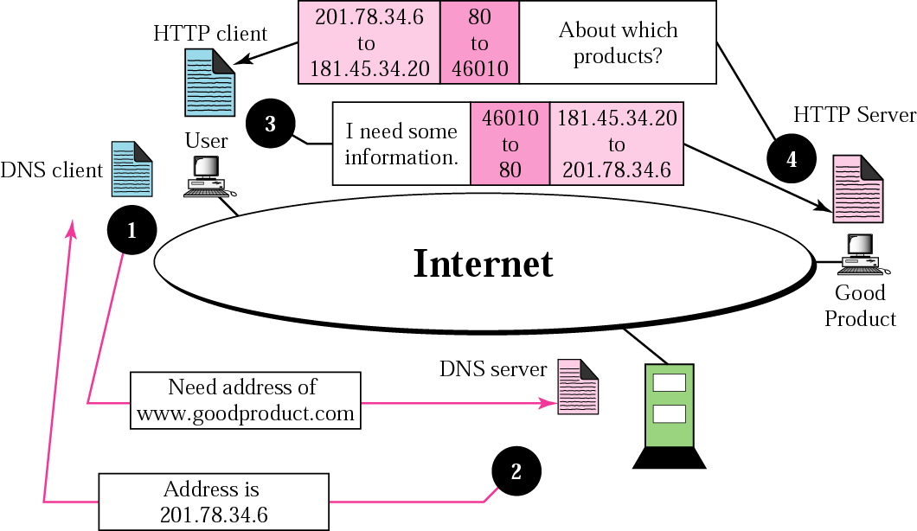
IP Addresses and Domain Names at 50000ft

Slide 18
DNS
Domain Name System
Maps host names to IP addresses and vice versa
A tree for forward queries – What is the IP address of paradox.sis.pitt.edu?
A tree for inverse queries – What is the host name of 136.142.116.28?
Common implementation is bind
DNS stores so-called resource records (RRs)

Slide 19
Domain naming hierarchy

Slide 20
DNS Services
In addition to address mapping, DNS provides
Host Aliasing (e.g., paradox.sis.pitt.edu can have two aliases - sis.pitt.edu and www2.sis.pitt.edu)
Mail Server Aliasing (e.g., prashant@sis.pitt.edu has to go to imap.pitt.edu)
Load Distribution (e.g., many sites use replicated web servers each running on a different end-system host)
DNS responds with the entire set of hosts, but rotates the order periodically

Slide 21
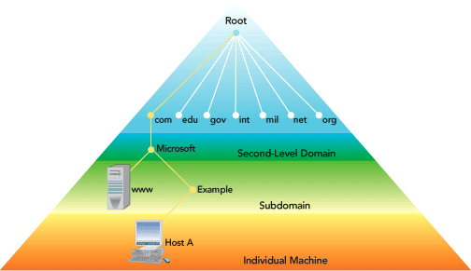
Domain Name Space

Slide 22
DNS is Distributed
Why not centralize DNS?
Single point of failure
DoS attacks
Traffic volume
Distant centralized database
Maintenance
Doesn’t scale!

Slide 23
DNS Components
Domain name space
Tree-structured name space to identify all internet resources
DNS database
Stored in a distributed database
Name servers
Server programs that hold information about a specific portion of the domain name tree
Resolvers
Programs that extract information from name servers based on client requests

Slide 24
DNS Database
Hierarchical database containing resource records (RRs) (name, IP address, other info about hosts).
Variable-depth hierarchy for names
essentially unlimited levels
uses . as the level delimiter in names
Distributed database:
resides in DNS servers throughout the Internet
Distribution controlled by the database
database divided into thousands of separately managed zones,
distribution and update of records controlled by database software.

Slide 25
Resource Records
Resource records (RRs) store the hostname to IP address mapping
Each RR has four fields
[Name, value, type, TTL]
Many different types - see list
TTL specifies how long the RR is valid
• ❑ A IPv4; Value = IP address;
Name = hostname
• ❑ AAAA IPv6 - same as A
• ❑ NS Value = nameserver address; Name = domain or zone name
• ❑ HINFO Host type and OS also specified; Rare
• ❑ CNAME Value = real name for alias specified in Name field
• ❑ MX Value = real name for alias of a mail server
• ❑ DNSKEY Public key for use in DNSSec
• ❑ WKS List of supported protocols and services; Rare

Slide 26
DNS Server Hierarchy
Each name server configured for a specific local zone
Includes subdomains
“Authoritative” source for that portion of hierarchy
Root servers are at top of hierarchy
Different root servers for different top level domains
Some redundancy within domain spaces to prevent bottlenecks

Slide 27
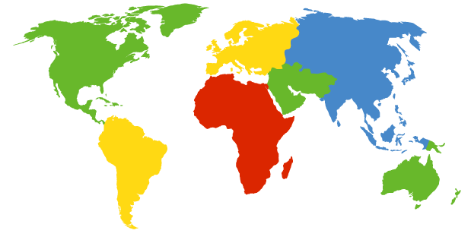
DNS: Root name servers
contacted by local name server that can not resolve name
root name server:
contacts authoritative name server if name mapping not known
gets mapping
returns mapping to local name server
a Verisign, Dulles, VA
c Cogent, Herndon, VA (also LA)
d U Maryland College Park, MD
g US DoD Vienna, VA
h ARL Aberdeen, MD
j Verisign, ( 21 locations)
k RIPE London (also 16 other locations)
i Autonomica, Stockholm (plus 28 other locations)
e NASA Mt View, CA
f Internet Software C. Palo Alto, CA (and 36 other locations)
m WIDE Tokyo (also Seoul, Paris, SF)
13 root name servers worldwide
b USC-ISI Marina del Rey, CA
l ICANN Los Angeles, CA

Slide 28
Local Name Server
Does not strictly belong to hierarchy
Each ISP (residential ISP, company, university) has one.
Also called “default name server”
Your WiFi router runs a local name server
When host makes DNS query, query is sent to its local DNS server
acts as proxy, forwards query into hierarchy

Slide 29
DNS Operation
User program requests IP address for a domain name
Resolver module in local host or ISP formulates query for local name server (same domain as the resolver)
Local name server checks local database/cache
If found returns IP address to the requestor.
If not found, queries other available name servers, starting down from the root of the DNS tree or as high up the tree as possible.
When response is received, local name server stores the name/address mapping in local cache
User program receives IP address or error message

Slide 30
DNS Vs Typical Client-Server
Typical client-server interaction
Client request connection to server
Server responds - handshakes take place
Session is initiated with interaction only between the two entities
DNS is a bit different
Client issues a DNS query to the server
Server accepts query - may contact other DNS servers
Upon obtaining the information, it returns it to the client

Slide 31
DNS Details
Many protocols employ DNS to translate user supplied names to IP addresses
DNS has to be called by http, ftp, smtp etc.
DNS can add delay to the communications process
DNS is an application level protocol, but is typically not used directly by the user
DNS queries and responses are on port 53 using UDP
TCP is used for zone transfers

Slide 32
DNS Name Resolution
Query begins with name resolver located in the user host system
If requested name not in cache, query sent to local DNS server
returns an address immediately, or
returns address after querying other servers
Two possible types of queries
Recursive – queries are passed up the name server hierarchy
Iterative – local name server retains responsibility for querying higher level DNS servers

Slide 33
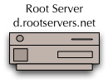

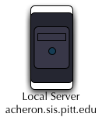
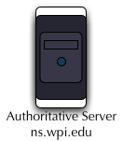


Recursive Queries
Local server does not know the IP address of host
It contacts the root server
The root server also does not know the IP address
It contacts an authoritative name server that returns the address
Root server returns the address to local server
Local server forwards the IP address to requesting host
Intermediate servers may also be used

Slide 34
Iterative Queries
If any server does not know the IP address, it may send the address of the next server in the list to the requesting host
The requesting host makes direct request to the new name server
Typically most requests are recursive, except when made to a root server
Query chains are a mix of iterative and recursive queries

Slide 35
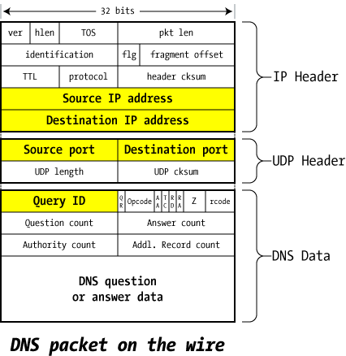
What data are in DNS packets?
Notice the encapsulation of the data
Refer to the web page for a good tutorial on how DNS works
Also looks at a specific vulnerability
Source: An Illustrated Guide to the Kaminsky DNS Vulnerability
http://unixwiz.net/techtips/iguide-kaminsky-dns-vuln.html

Slide 36
Zone Transfers
Zone
Name spaces are divided into zones based on separating “periods” in the name
Example: sis.pitt.edu used to be a zone
Example: pitt.edu is a zone
Each zone maintains primary and secondary name servers
Secondary servers periodically poll primary servers to obtain zone data
If data has changed, a zone transfer is initiated that downloads the entire database

Slide 37
Inverse Lookup
Inverse look-ups are performed in a slightly different way by DNS servers
Example: Lookup 136.142.116.28
The query resolves 28.116.142.136.in-addr.arpa
Similarities between forward and inverse look-up
The top-level domain “arpa” has exactly one sub-domain “in-addr”
The host address (say 28) comes first just like forward lookups
Inverse trees are often not current and could lead to potential security problems

Slide 38
DNS Software
Berkeley Internet Name Domain (BIND)
Most common implementation named
Many versions exist (latest is 9.7.0rc1)
Production version is 9.5.2-P2 (see www.isc.org)
ATLAS
Advanced Translation Look-up And Signaling
Verisign’s proprietary DNS software
Microsoft has its own DNS software since Win2K
djbdns - Free DNS software
See www.tinydns.org

Slide 39
ICMP
Internet Control Message Protocol - ICMP is supposedly a very low-key protocol to answer simple requests
It sits below the transport layer and above the IP layer of the protocol stack
No port numbers of any kind - but it has types and codes in the first two bytes of the header
No concept of client or server - effects are mostly internal to the recipient host
No guarantees of delivery
Hosts need not be listening to ICMP messages
ICMP messages can be broadcast to hosts
Can be a source of information leaks - e.g., host is unreachable

Slide 40
ICMP Codes and Types
ICMP contains first 8 bytes of IP header that caused the ICMP response
Ping transmits ICMP (8,0) and receives ICMP (0,0)
Traceroute uses ICMP
Sends an ICMP with TTL = 1, 2, 3, 4 ... to destination
Each router along the path detects the TTL as expired and responds with an ICMP (11,0) allowing traceroute to determine the route
Type | Code | Remark
0 | 0 | Echo reply (ping)
3 | 0 | Destination Network Unreachable
3 | 1 | Destination Host Unreachable
3 | 3 | Destination Port Unreachable
8 | 0 | Echo request
9 | 0 | Router advertisement
11 | 0 | TTL Expired
12 | 0 | IP Header Bad

Slide 41
Legitimate ICMP Activity
Routers deliver “host unreachable” message
Common when hosts are shut down for maintenance or otherwise
Can be used in reconnaissance information
Port unreachable
ICMP can be used to check if a UDP port is open
TCP ports reply with a RST/ACK flags
Routers sometime inform you that ICMP traffic is blocked!
Router redirect messages
Informs host of a more optimum router
Need to fragment packets because MTU is exceeded
TTL expired (time exceeded in transit)

Slide 42
Slide from Agrawal

Slide 43
Example: E-mail
Characteristics of E-Mail
Store-and-forward
Asynchronous communications
Mailbox and machine identifiers
Systems
Mail server
Mail client
Protocols
Inter-server: SMTP
Client-server: POP3/IMAP4

Slide 44
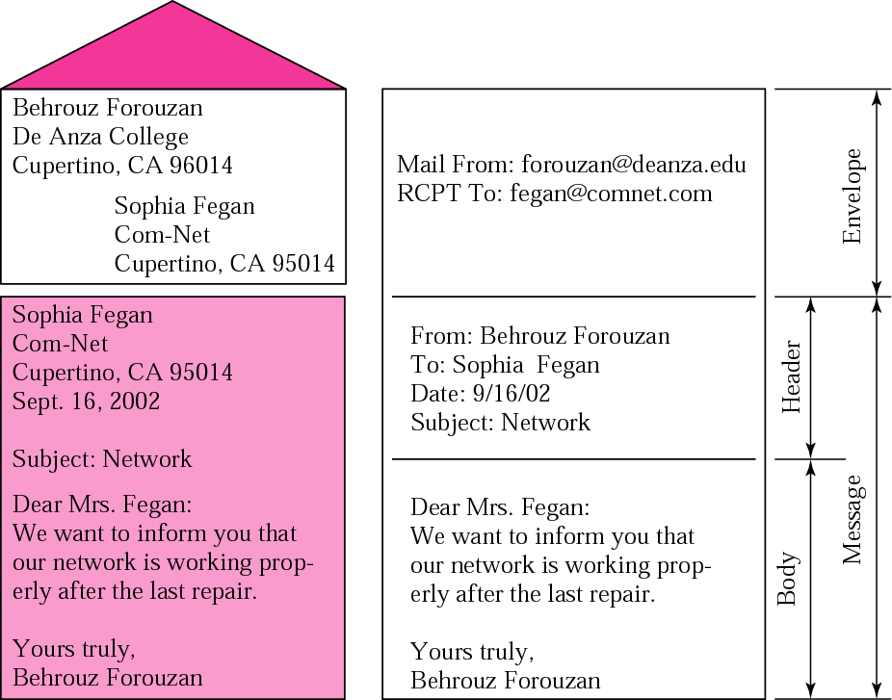
Structure of a Mail Message

Slide 45
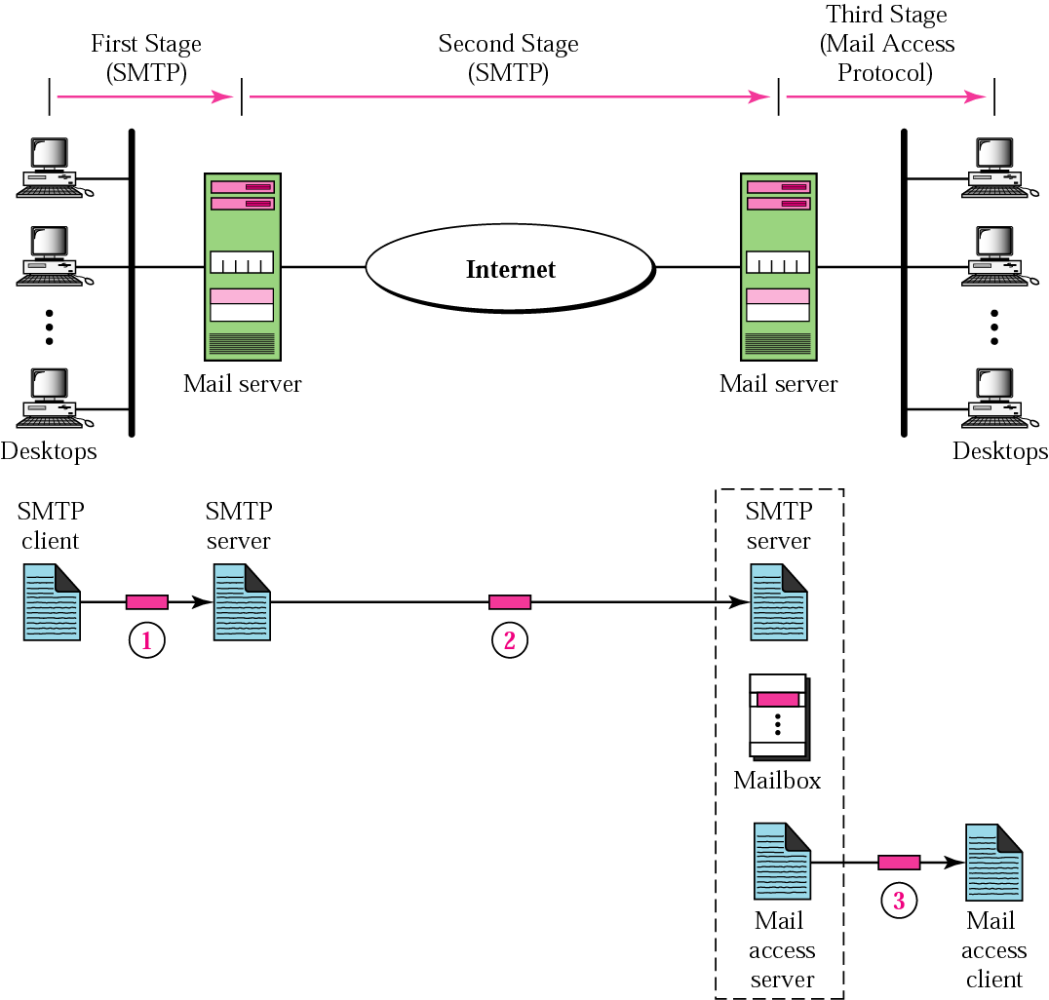
E-mail System Structure

Slide 46
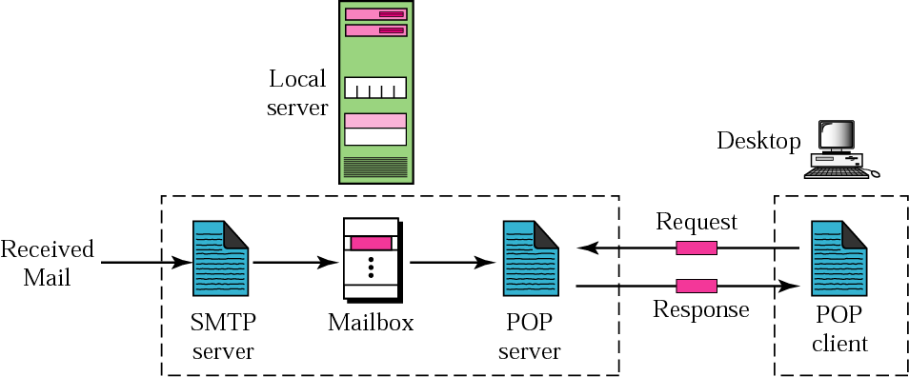
Post Office Protocol (POP)

Slide 47
Example: File Transfer
The traditional means of sending non-ASCII information
Users needed accounts on both machines
Anonymous logins evolved to make information public
Archie servers were established to help users locate public FTP sites

Slide 48
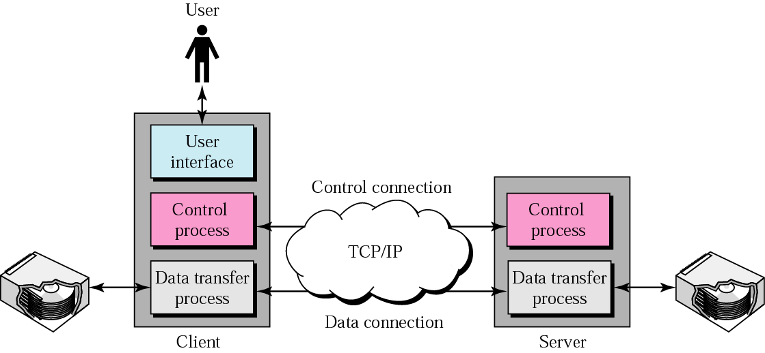
FTP

Slide 49
Example: Telnet
Allows users to remotely log in to a machine
Permits ASCII-only interface

Slide 50
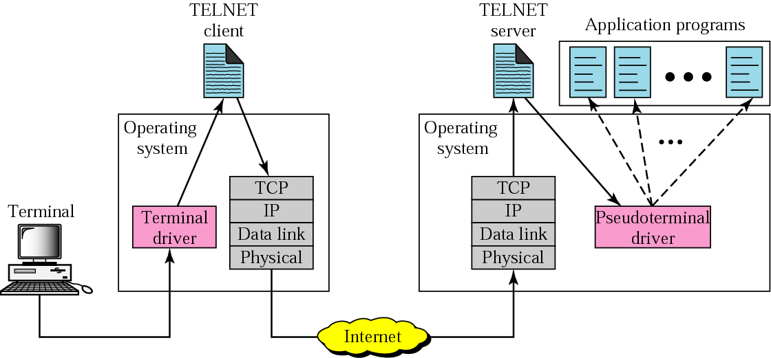
Telnet

Slide 51
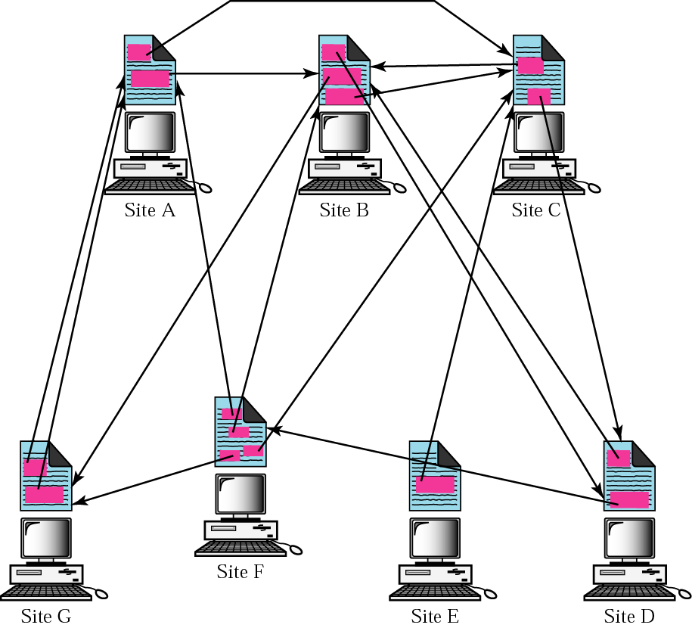
Distributed Services and WWW

Slide 52
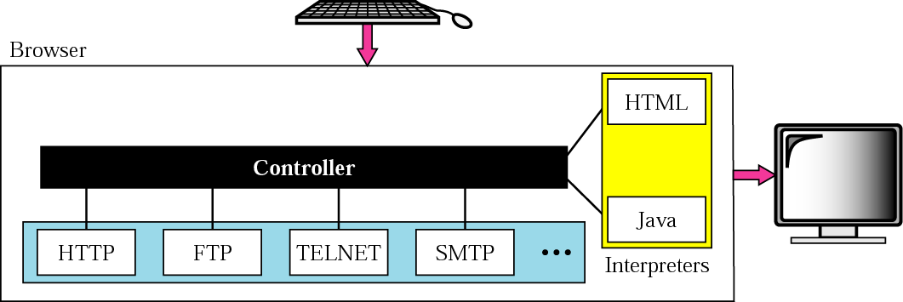
Components of the WWW

Slide 53
HTTP
Very general protocol to access data on the Web
Request-Response protocol
Information specified by a Uniform Resource Locator (URL) or Uniform Resource Identifier (URI)
Notes:
After a web client (browser) has created a TCP connection to a web server, the client can begin requesting the web page from the server. Most often, the protocol used to transfer the web page is HTTP. The HTTP application layer protocol, defines how files can be transferred between two computers. HTTP was specifically created for the purpose of transferring files between web servers and web clients.

Slide 54
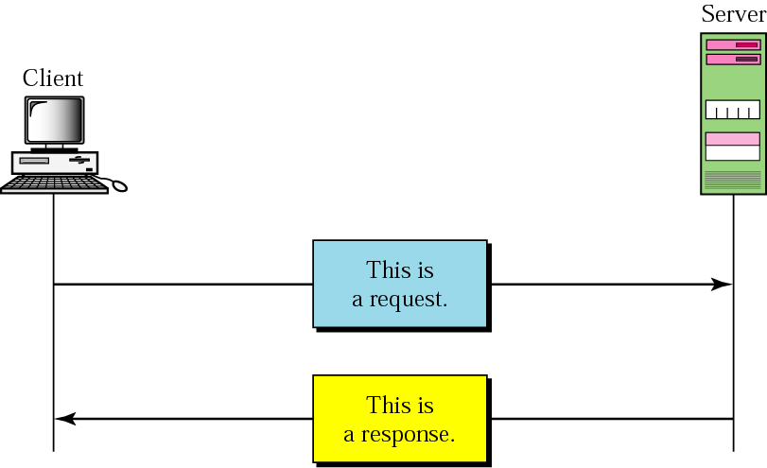
HTTP
Notes:
HTTP defines several commands and responses, with the most frequently used being the HTTP GET request. To get a file from a web server, the client sends an HTTP GET request to the server, listing the filename. If the server decides to send the file, the server sends an HTTP GET response, with a return code of 200 (meaning OK), along with the file’s contents.
Web pages typically consist of multiple files, called objects. Most web pages contain text as well as several graphical images, animated advertisements, and possibly voice or video. Each of these components is stored as a different object (file) on the web server. To get them all, the web browser gets the first file. This file can (and typically does) include reference to other URIs, so the browser then also requests the other objects.

Slide 55
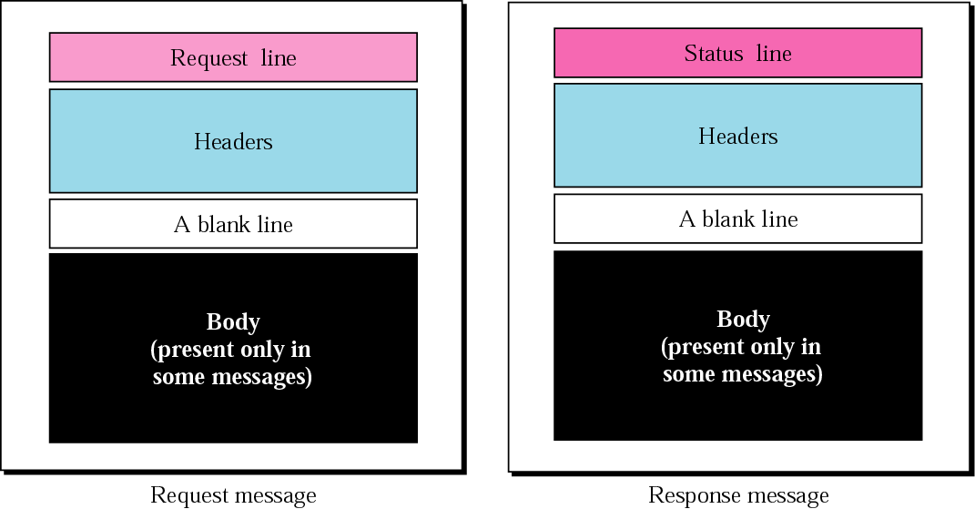
Format of HTTP Messages

Slide 56
Uniform Resource Identifiers
For a browser to display a web page, the browser must identify the server that has the web page, plus other information that identifies the particular web page.
http://www.certskills.com/blog
In common speech, many people use Web address, Universal Resource Locator (URL), but indded RUI is the correct formal term.

Slide 57
Structure of a URI used to Retrieve a Web Page

Slide 58
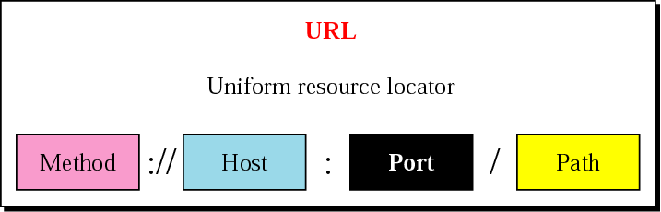
Structure of a URL

